Slide 1
R15 Academic Research Enhancement Awards (AREA) for PUIs: A mini-R01 Funding Research with Undergraduates
Not at a PUI? Check out the analogous Research Enhancement Award Program (REAP) – for enhancing research at graduate and health-profession schools
Erin J. Wamsley
Associate Professor
Furman University Department of Psychology
erin.wamsley@furman.edu
Notes:
Good morning– happy to be here today to talk with you about R15 grants from NIH.
I’ll be going over some of the basics about what this grant opportunity is, and along the way, I’ll also give you some tips based on my own personal experience with how to be successful in obtaining funding through this mechanism
I’ll be focusing on the “Academic Research Enhancement Awards” from NH, which are specifically aimed at funding research at primarily undergraduate institutions (PUIs); but if that doesn’t apply to you, note that there is an analogous program now called the Research Enhancement Award Program (REAP), focused on funding research at graduate and health-progressions focused schools

Slide 2
Notes:
So, there are over 4,000 institutions of higher education in the United States, but of course its well known that the majority of federal research dollars goes to a relatively small group of elite research institutions
for example, these 100 institutions plotted here received over 80% of the total NIH dollars awarded in FY2018
Now that’s largely because there is great research going on at these places that deserves this funding
But it can also happen that you might be doing really great, groundbreaking research at a smaller school that doesn’t receive much NIH funding, or have a very strong research infrastructure, and for a variety of reasons, you could be at a disadvantage of receiving a piece of this pie, despite the excellent work happening in your lab
4. This really disadvantages undergraduate students at smaller, less research-focused institutions, as they may not have the opportunity to work in a high-impact, well-funded laboratory

Slide 3
Your Grant Must Meet the Objectives of the R15 Program from NIH Funding Opportunity Announcement PAR-18-714
To support for meritorious research at undergraduate-focused institutions
To enhance the research environment at these institutions
To give undergraduate students an opportunity to gain significant biomedical research experience
TIP 1: Learn these Documents Like the Back of Your Hand
AREA Website: https://grants.nih.gov/grants/funding/r15.htm
Current R15 FOA: https://grants.nih.gov/grants/guide/pa-files/PA-18-504.html
Notes:
So that’s really the disparity that the R15 grant mechanism was designed to address – these grants are reserved to support high-quality research at institutions that have historically received little NIH support
Objectives of the program
So my first tip is that If you are interested in applying to NIH for R15 funding, it is essential that your application be crafted to meet these objectives – to facilitate that, you really have to study NIH’s messaging on this program, to become intimately famlity with their goals for this program – you are going to want to read and reread NIH’s website describing the AREA program, and the official funding opportunity announcement describing the program, ensuring that your grant pushes every button that they are looking for If your application does not clearly describe how you will contribute to these objectives, it wont be funded
I believe these slides can be made available to you aver the session

Slide 4
Eligibility
Must be a primarily undergraduate institution
Institution must have received <$6 million of NIH funding in 4 of the last 7 fiscal years.
PI cannot simultaneously be PI on another R-series NIH research grant
Must substantively involve undergraduate researchers
Notes:
To be considered for R15 funding, you and your institution must meet these eligibility criteria
Very early on, you should consult with your school’s grants office to ensure that your institution does meet these criteria

Slide 5
What an R15 Is and Is Not
Funds a specific research project, just like any other NIH research award
3 years, renewable, direct costs <$300,000
“Not a training grant”, and no special sections re: undergraduate training
Not an “easier to get” R01
TIP 2: BUT it is essential that your Facilities & Other Resources section contains detailed information about the involvement of undergrads in this work.
TIP 3: Reach out to program officers at least 6 months before the application deadline. Send them a well-developed summary (specific aims) and ask advice on the “programmatic relevance” of your idea.
https://www.niaid.nih.gov/grants-contracts/new-tool-find-program-officer
Notes:
But an R15 is in most respects just like other R-series NIH grants—
The funding is given to support a particular research project of a particular principle investigator
As compared to an R01, the amount and duration of funding will be less – maximum allowed direct costs = 300,000, across 3 years. But like an R01, this is a renewable grant – so this is not something just to “get you started” and then move on to the next thing – this is a mechanism that could fund your lab in perpetuity if you continue to be successful in the competitive renewals
Importantly, even though a main goal of this program is to support undergraduate researchers, this is not a raining grant – undergraduate researchers are supported by funding the specific research projects of PIs at these schools
So there are no special sections for describing training and education programs for the students or any such thing – all the sections of the grant are just th same as those you would write for an R)!
HOWEVER – TIP2 – because it is so essential that your grant demonstrate how it achieves the goals of the R15 program, you must work in really compelling and detailed information about specifically how undergraduates will be involved in the research – because there is no special section for this, it best fits as rolled into the Facilities & Resources section – but really, mention of undergraduate researchers should pervade all sections of the grant – the budget, the aims, everything
6. Because of this – you should not think if the R15 as just an “easier to get” R01 – this is a program with its own specific goals, and repackaging an R01 application as an R15 isn’t necessarily going to meet those goals – the grant must be tailored to show how undergrauduate research will be enhanced – and that isn’t easy
7. Last tip on this slide – and this is my most important – really early on you need to communicate with program officer(s) at NIH to gauge THEIR opinion of how well your grant idea fits the objectives of the program, and how interested their institute(s) might be in your work – on the NIH reporter website, you can find program officers and institute that match your research – send them as summary – a draft specific aims page, and ask for their input on the fit of your work to their program – getting feedback direct from the PO is essential, because you don’t want to waster your time sending your grant to an institute that is not interested in it

Slide 6
Review Process / Criteria
Evaluated according to the same criteria as any other NIH grant
May be reviewed by the same study sections as other research grants submitted to your institute, or by an R15 “special emphasis panel”
TIP 4: A successful R15 has compelling preliminary data.
TIP 5: You can specify the study section(s) that you want your grant to go to – and this has a huge impact. View study section rosters (https://public.csr.nih.gov/StudySections) to see who is on them, and ask your program officer for advice on this.
Notes:
Once your R15 is submitted, it will be evaluated by an NIH study according to the same criteria as another other grant (SIGNIFICANCE, INVESTIGATORS, INNOVATION, APPROACH, ENVIRONMENT). But reviewers will be aware of this is an R!5 grants, they will be aware of the goals of this funding mechanism, and they will take into account the extent to which your grant meets those goals in forming their opinion of your proposal.
TIP 4– you’ll read in the FOA that preliminary data are not required for an R15. In my opinion, that’s NOT TRUE. Obtaining an NIH grant is a super-competitive process, and if you don’t to everything possible to maximize the competitiveness of your application, you don’t have a chance. Many of the R15 applications your are competing against DO have really strong preliminary data included, and if yours doesn’t… you are a a competitive disadvantage that you can’t afford in this funding environment
What study section will review your application?
Well, your R15 might be reviewed by the same regular standing review panels that handle other r-series grants, or alternatively, it could be assigned to a “special emohasis panel” that is assessing ONLY R15s – As you might imaging, the specific review panel that your grant is assigned to an have a MASSIVE impact on your chances of getting funding
for that reason my final tip is that you have to be aware that YOU can specify the study section(S) that you prefer your grant to be assigned to – you can research the available study sections ahead of time, and even view their memer rosters online – certainly this would be a great point to ask your program officer for advice on

Slide 7
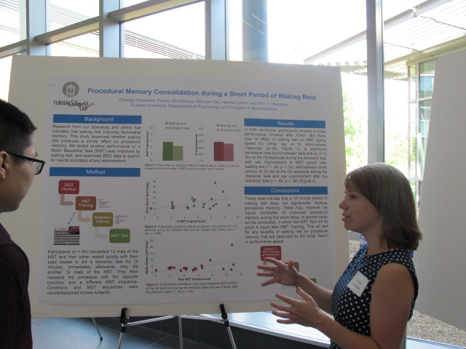
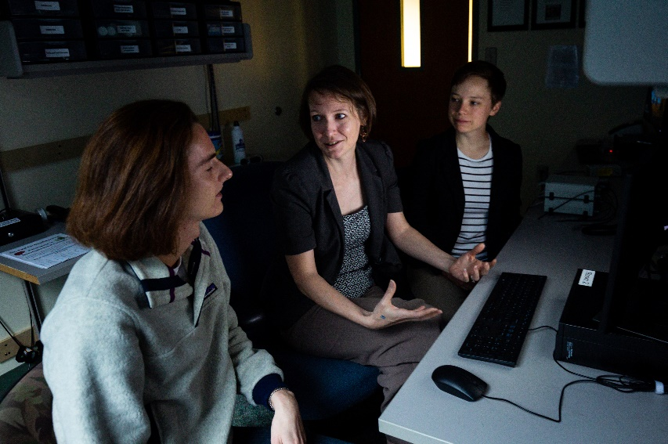
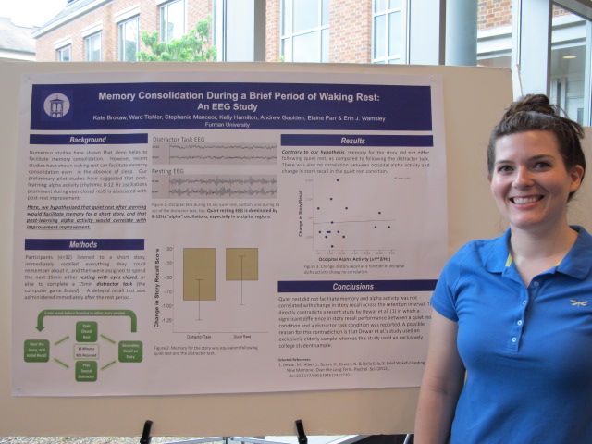
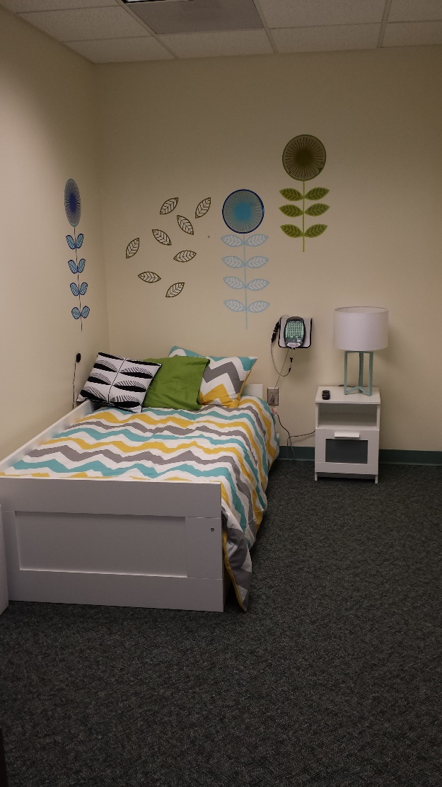
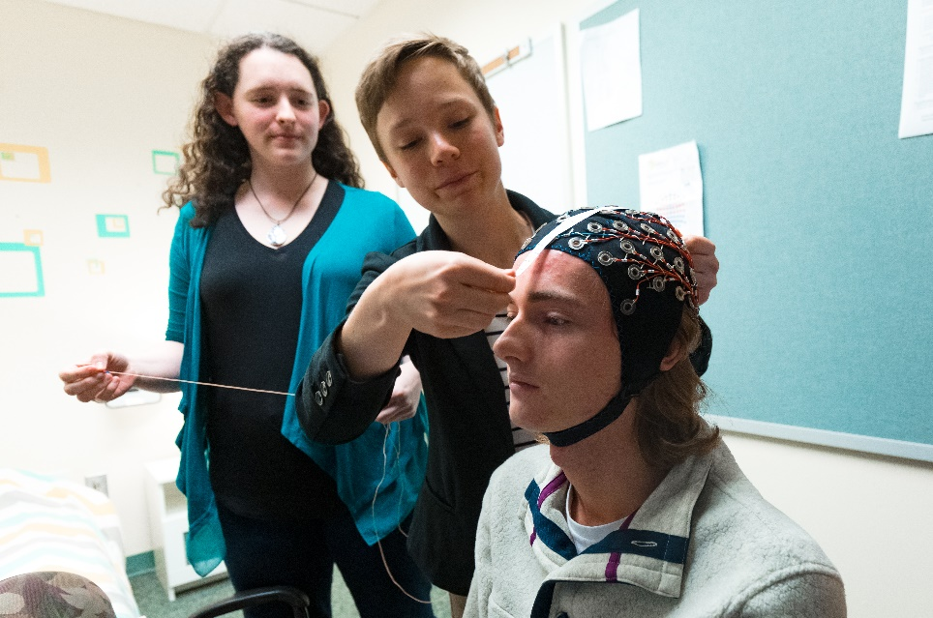
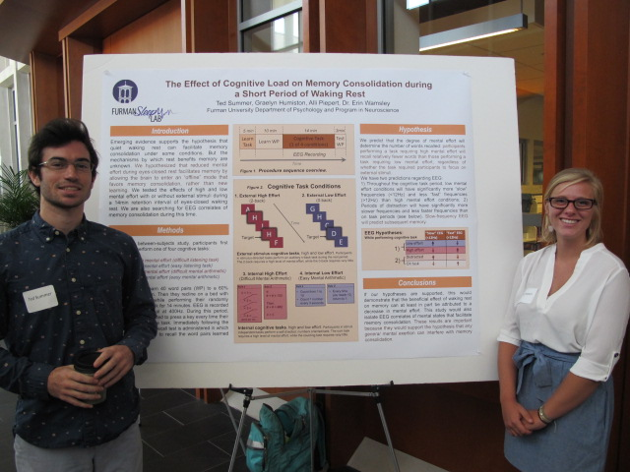
Questions?

